Slide 1



On your MWB:
What do you remember about what happened to Maria?
Notes:
What is digital forensics?

Slide 2

Messages
Topic Question
Lesson Question
How can digital artefacts be explored and analysed to reveal information about a person?
What is a brute force attack? What are VPNs, cookies, Internet search histories?

Slide 3






Computing
Digital Forensics
Lesson 7
How can instances of online grooming be avoided?
Computer Science
Aim
7
Information Technology
Lesson 5
How do we protect ourselves against unwanted attention online?
8
5
Online Safety
Lesson 8
What is my understanding of the lesson questions throughout this topic? & SRT
Lesson 4
How can a database be questioned?
4
Lesson 2
Do we really have privacy? Is our location always being tracked by the apps on our phones?
6
2
Lesson 6
What is a brute force attack? What are VPNs, cookies, Internet search histories?
Lesson 1
What data do digital devices store about their users?
3
Lesson 3
What are the ethical issues of online adverts? What is metadata?
1

Slide 4
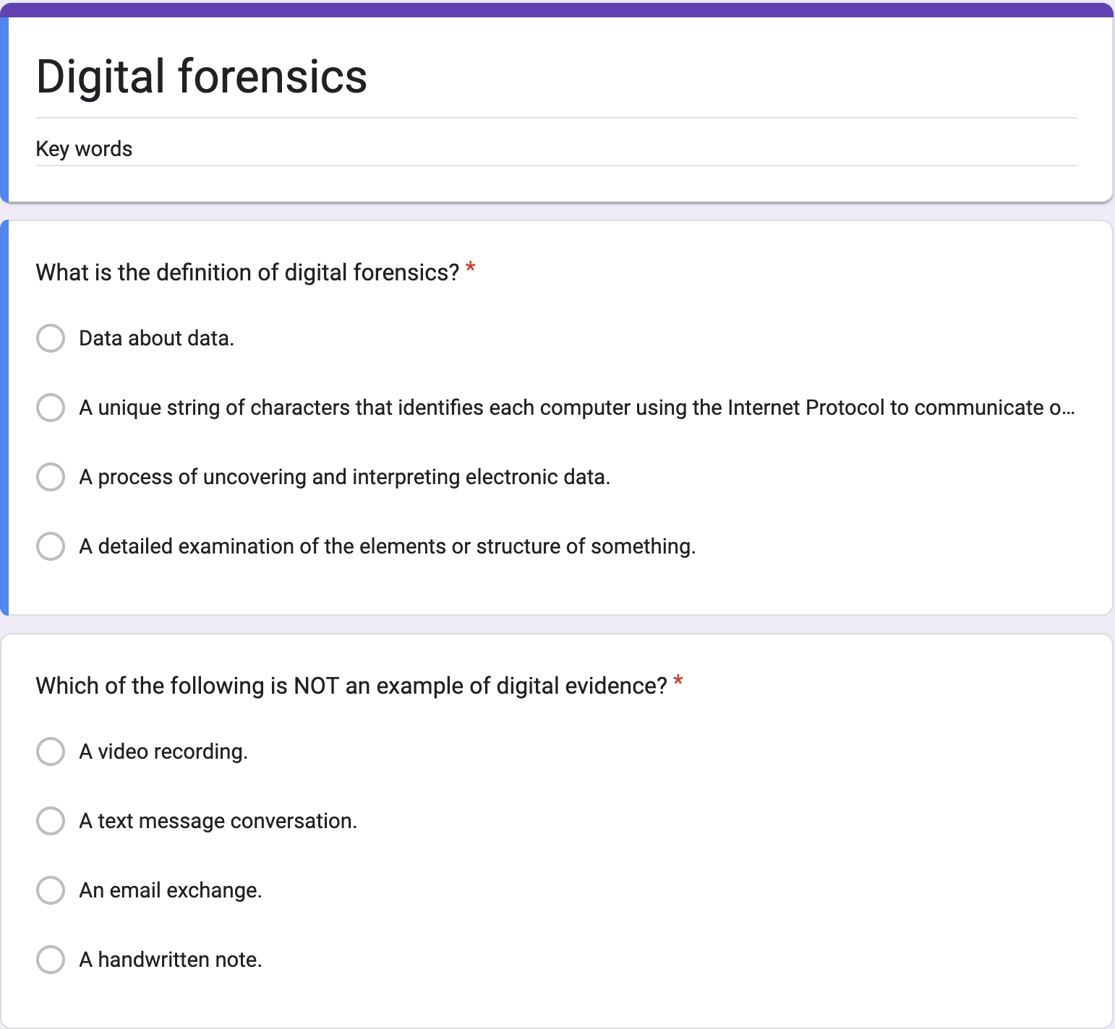
Keyword Recall
From Google Classroom open the Digital Forensics Quiz and complete the 10 questions

Slide 5
Careers in Digital Forensics
Digital Forensic Investigator
Police Digital Forensics Officer
Forensic IT Technician
OVERVIEW
Recovers and analyses digital evidence from devices for criminal investigations and court proceedings.
OVERVIEW
Works within a police force extracting evidence from phones, computers and other devices seized during investigations.
OVERVIEW
Supports forensic investigations by imaging drives, recovering deleted files and maintaining evidence integrity.
AVG SALARY £28,000 – £55,000
AVG SALARY £25,000 – £45,000
AVG SALARY £22,000 – £40,000
SOFT SKILLS
Analytical thinking
Attention to detail
Written communication
Ethical judgement
Problem solving
SOFT SKILLS
Integrity & discretion
Resilience under pressure
Teamwork
Report writing
Critical thinking
SOFT SKILLS
Patience & meticulousness
Logical reasoning
Time management
Collaborative working
Curiosity & initiative
QUALIFICATIONS
Degree in Computer Forensics / Computing
A-levels in Maths, IT or Science
EnCE or GCFE certification
GCSEs incl. Maths & English (gr 4+)
QUALIFICATIONS
Degree or HND in IT / Forensics
Police vetting clearance
ACPO / NPCC guidelines training
GCSEs incl. Maths & English (gr 4+)
QUALIFICATIONS
Level 3 IT or Computing qualification
CompTIA A+ or Network+ cert.
Apprenticeship pathway available
GCSEs incl. Maths & English (gr 4+)

Slide 6
Vocabulary List
Analysis | A detailed examination of the elements or structure of something.
Brute Force Attack | A brute force attack is a hacking method that uses trial and error to crack passwords, login credentials, and encryption keys
Chain of Custody | The term Chain of Custody refers to the chronological documentation associated with the evidence. This records the paper trail, custody, transfer, analysis and disposal of the evidence.
Chronological | Following the order in which they occurred. "the entries are in chronological order"
Digital Forensics | Digital forensics is the process of uncovering and interpreting electronic data. It is the process of identifying, preserving, analysing, and documenting digital evidence.
IP Address | A unique string of characters that identifies each computer using the Internet Protocol to communicate over a network i.e. 123.23.46.232
MAC Address | A MAC address is the unique identifier that is assigned by the manufacturer to a piece of network hardware
Metadata | Metadata is data about data - it allows a computer to construct an image.

Slide 7

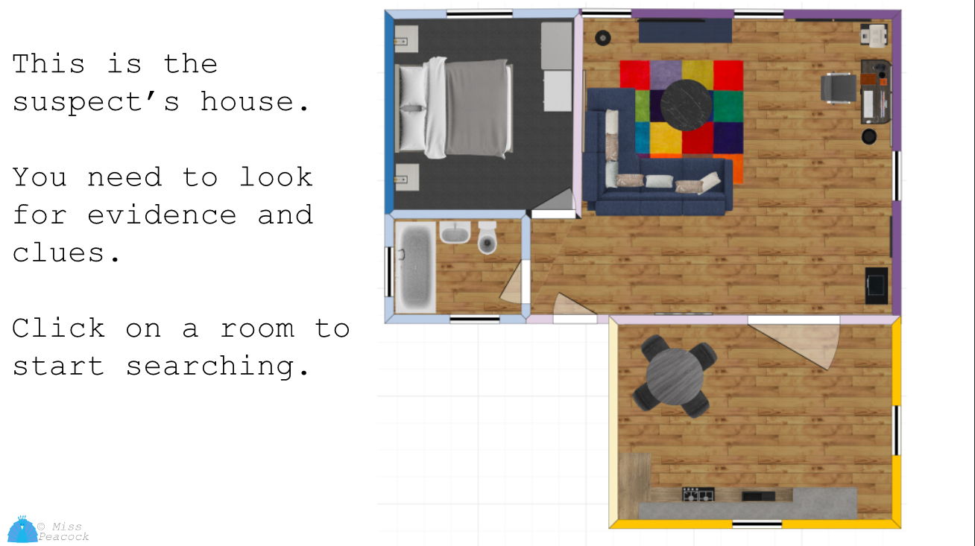




Recap
Last lesson you searched the home of suspect Ashley Williams.
You had to unlock his safe and his computer in order to gather evidence.

Slide 8
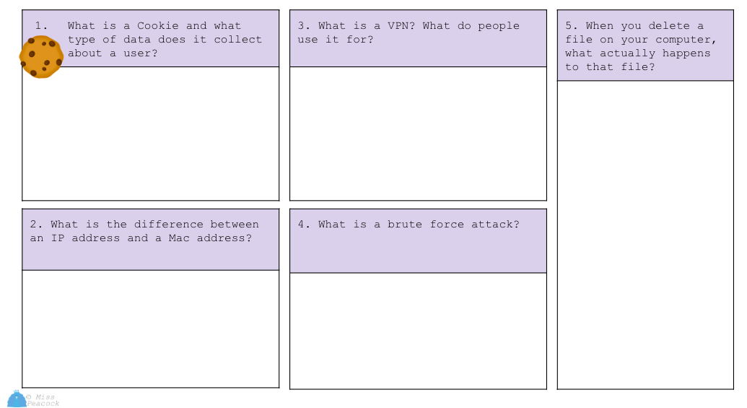

What do you think these are?
From Google Classroom open 5. What are VPNs, Cookies etc
Read the questions, but DO NOT attempt them… yet.

Slide 9
Brute Force Attack
To work out the password for the computer you used a dictionary hack which is a form of a brute force attack.
This is where different words are used through trial and error to work out a password.
You found the words: Maria, Ibiza and 23 in the journal but then you had to put these words in the correct order. Luckily you were given other clues (use capital letters and wordnumberword) otherwise you might have never been able to hack the password.
These are some of the combinations you might have tried:
MARIA 23 IBIZA IBIZA 23 MARIA IBIZA23MARIA MARIA23IBIZA

Slide 10
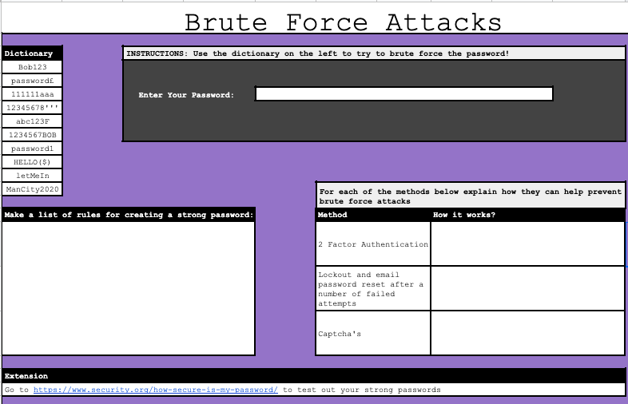


Brute Force Attacks
From Google Classroom open the Brute Force Activity Walkthrough
Use the words in the dictionary to try to brute force the password.
Make a list of rules for creating a strong password.
Explain how each of the methods can prevent brute force attacks - you can use the web to research these!

Slide 11
Showcase what you have learnt?
Go to the tab:
5. What are VPNs, Cookies etc.
Answer question 4
What is a brute force attack?

Slide 12


Get Digging
The files on the computer and messages on the Samsung phone
The digital forensic team have found files that show that Ashley Williams was stalking Maria for a substantial amount of time (before he even contacted her on instagram). The files included photographs of Maria and her friends at the shops and walking home from school. These were taken using the Samsung phone found in the house.
There were also photographs of other young girls including indecent imagery.

Slide 13
Get Digging
The files on the computer and messages on the Samsung phone
Internet history searches revealed several
instagram accounts set up from the same IP address. All the messages sent to Maria had the IP address and MAC address in the source code.
The same MAC address and IP address were used to send other girls messages.
What are MAC address and IP address? What are they used for?

Slide 14
Covering his tracks
How could suspect Ashley Williams covered his tracks?
Answers could include:
Deleting cookies
Clearing internet history
Deleting files
Using a VPN
Let’s look into these in a bit more detail

Slide 15
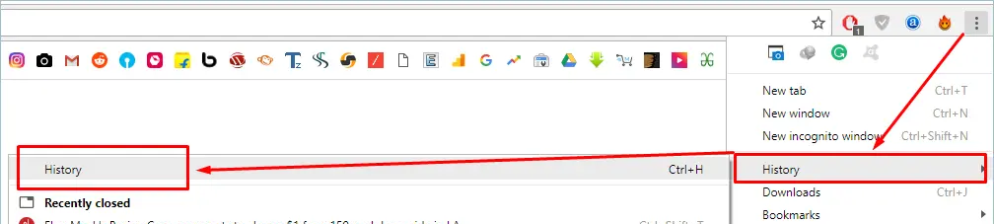
Internet History
How to view your internet history

Slide 16
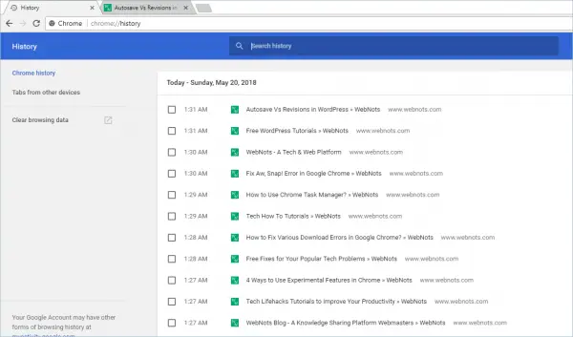
Internet History
It will show the time, date and the name of the website and webpage you were on.
You can click on the link to go back to that site again.
And you can also clear your browsing data

Slide 17
Is it gone for good?
You spend some time surfing the web, close your browser, and clear your internet history. But is your history really deleted, and is there any way to find out what websites you visited?
Your browser history is stored just like everything else on your computer, as a file (or collection of files). Clearing your browser history merely deletes these files from your hard drive. However files from your hard drive can be recovered using specialist software.

Slide 18

Deleting files permanently - LTT

Slide 19
Showcase what you have learnt?
Go to the tab:
5. What are VPNs, Cookies etc.
Answer question 5
When you delete a file on your computer, what actually happens to that file?

Slide 20

Cookies

Slide 21
Showcase what you have learnt?
Go to the tab:
5. What are VPNs, Cookies etc.
Answer question 1
What is a cookie and what type of data does it collect about a user?

Slide 22

What is a VPN?

Slide 23
Showcase what you have learnt?
Go to the tab:
5. What are VPNs, Cookies etc.
Answer question 3
What is a VPN? What do people use it for?

Slide 24
Digital Forensic Investigators-what do they search for?
They will examine a device very closely. They may analyse the following (not an exhaustive list):
The hard drive - what files are on the hard drive but also what files
have been purposefully destroyed - they use specialist software for this.
Internet search history, cookies and any temporary files. What the suspect has been searching can be very important in an investigation.
Location settings - Have any apps stored the location?
IP & MAC addresses from emails and messages - this can show what devices have been communicating.
Other data - there is loads more data that our devices collect about us i.e health data.

Slide 25

What is a brute force attack?

